Slide 1
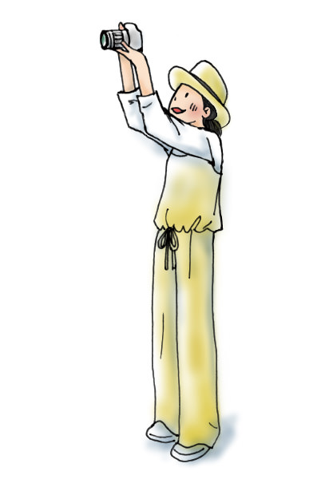
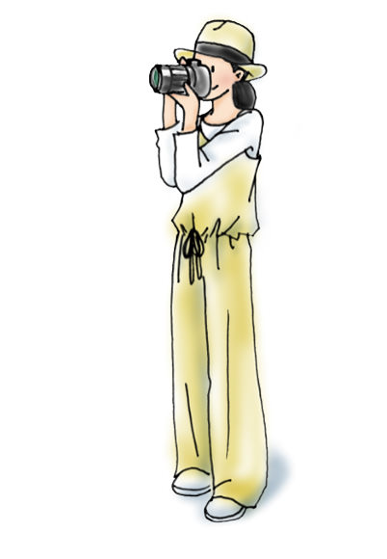
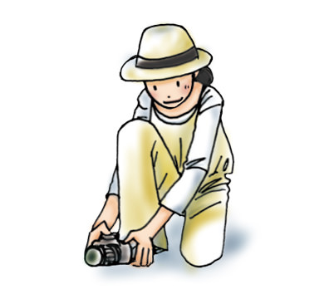
POSISI/LEVEL
snapshot.canon-asia.com

Slide 2
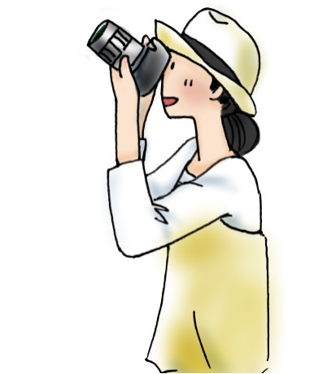


SUDUT

Slide 3
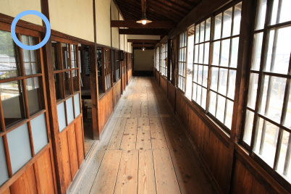
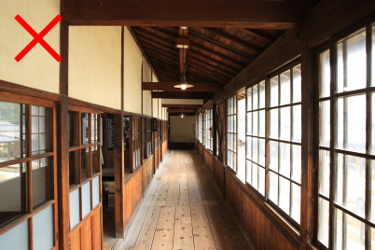
1. Mengambil keputusan level
EOS 5D Mark III/ EF24-70mm f/2.8L II USM/ FL: 24mm/ Aperture-priority AE (f/4, 1/30 det., EV+0,3)/ ISO 160/ WB: Auto
EOS 5D Mark III/ EF24-70mm f/2.8L II USM/ FL: 24mm/ Aperture-priority AE (f/4, 1/40 det., EV+0,3)/ ISO 200/ WB: Auto

Slide 4
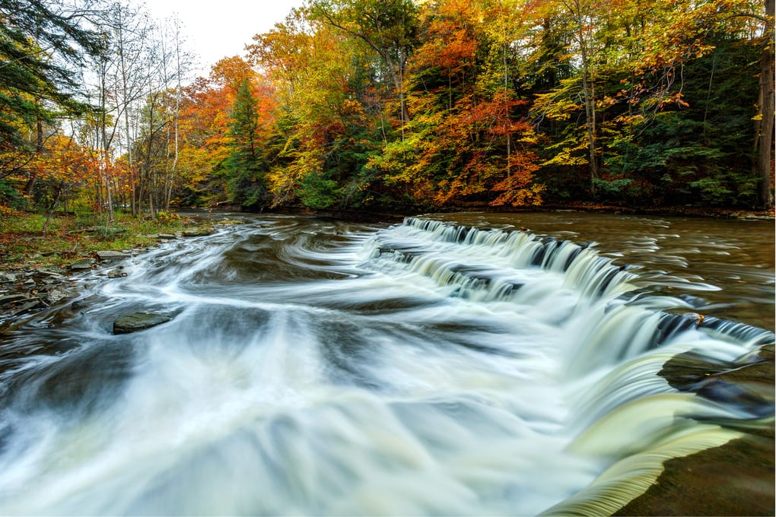
Long Exposure: 1/6s

Slide 5
Short Exposure: 1/8000s

Slide 6
Aperture (f)

Slide 7


